Slide 1

LOAN portfolio evaluation
PRESENTED BY BHAGWATI MATHPAL
7th December 2021

Slide 2
PROBLEM STATEMENT
To analyze lender’s loan portfolio based on set criteria and provide suitable recommendations to management
The criteria are as follows
Gender
Marital status
Number of dependents
Level of Education
Employment status
Applicant income
Co-applicant income
Credit history
Loan amount
Loan amount term
Property area

Slide 3
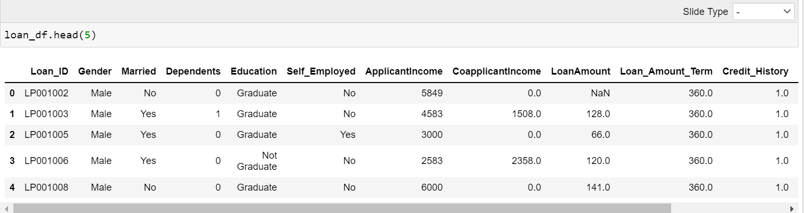
a glance of data set

Slide 4
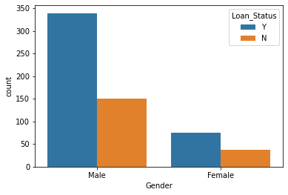
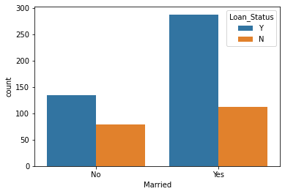
PROFILE OF EXISTING BORROWERS
GENDER
MARITAL STATUS

Slide 5
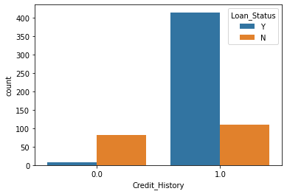
PRoFILE OF CREDIT HISTORY

Slide 6
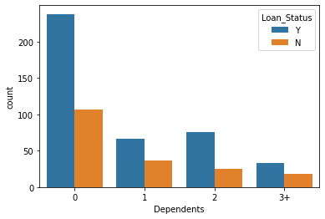
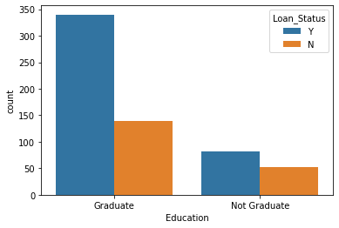
PROFILE OF EXISTING BORROWERS
NUMBER OF DEPENDENTS
EDUCATION

Slide 7
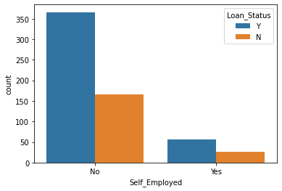
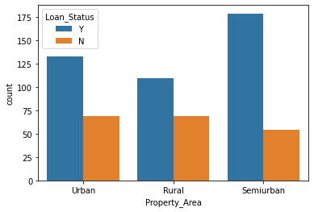
PROFILE OF EXISTING BORROWERS
EMPLOYMENT
PROPERTY AREA

Slide 8
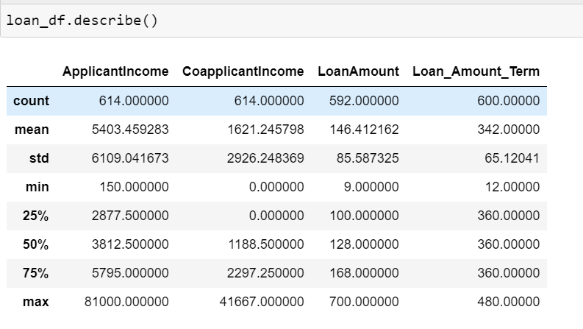
Description of some statistical terms FOR NUMERICAL characteristics

Slide 9

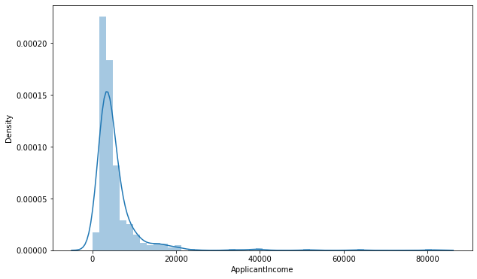
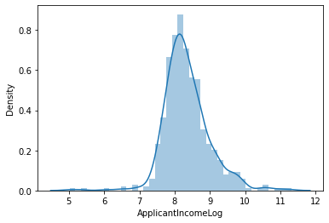
DISTRIBUTION OF NUMERICAL CHARACTERISTICS
APPLICANT INCOME

Slide 10


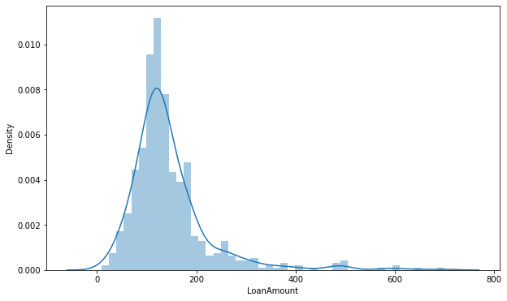
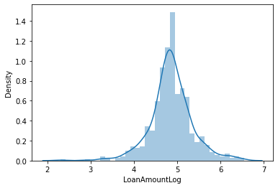
LOAN AMOUNT

Slide 11


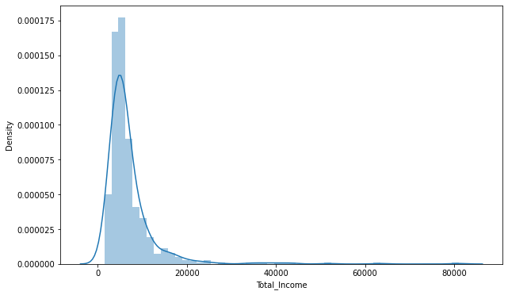
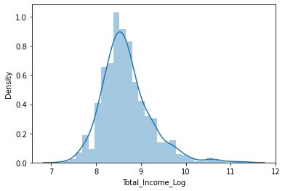
TOTAL INCOME (APPLICANT INCOME + COAPPLICANT INCOME)

Slide 12
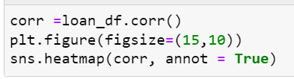
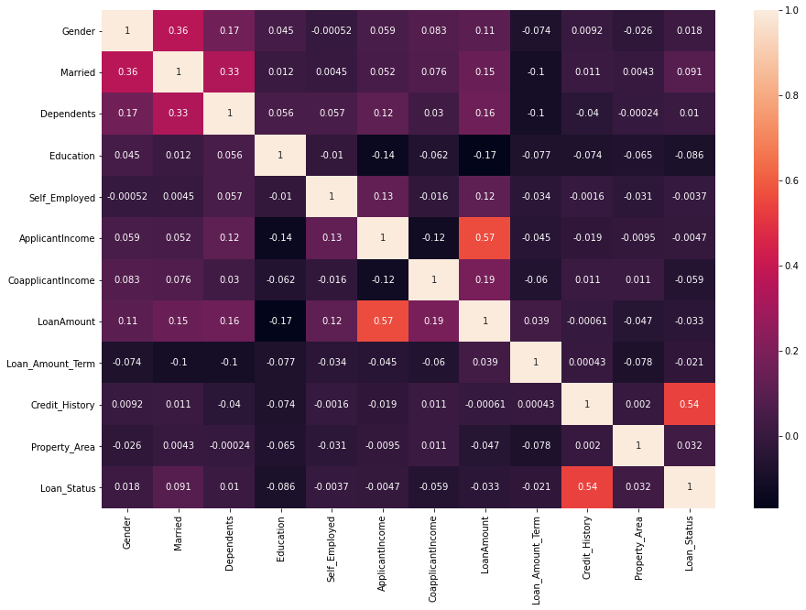
Correlation BETWEEN DIFFERENT Variables
Notes:
12

Slide 13
OBSERVATIONS
After analyzing the data set I have found that following charactristics play an important role in approval of loan
Applicant income
Credit history
Marital status

Slide 14
RECOMMENDATIONS TO MANAGEMENT
RISK MANAGEMENT : Diversify across various characteristics
BUSINESS DEVELOPMENT: Identifying portfolio gaps and creating sales opportunities

Slide 15
THANK YOU Q & A

